Slide 1
Mocha: Multinode Cost Optimization in Heterogeneous Clouds with Accelerators
Peipei Zhou, Jiayi Sheng, Cody Hao Yu, Peng Wei, Jie Wang, Di Wu, Jason Cong
peipei.zhou@pitt.edu
Notes:
Hi everyone, My name is Peipei Zhou. I’m glad to present our work Mocha. Mocha stands for Multinode Cost Optimization in Heterogeneous Cloud with Accelerators. This is the work that I had been working on when I was a PhD student at UCLA. Currently, I am serving as tenure-track assistant professor at University of Pittsburgh, Electrical and Computer Engineering department.

Slide 2
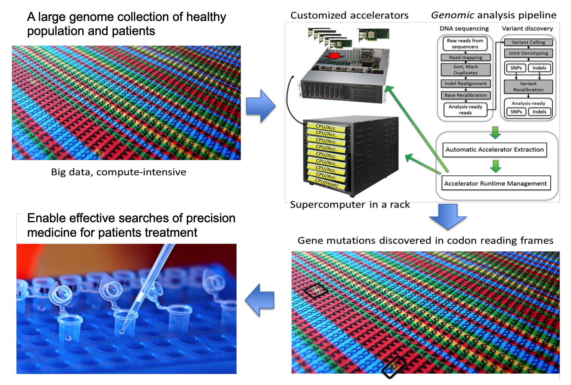
Application Domain: DNA/RNA Genome Analysis Toolkit
Notes:
In this work, we use genome analysis toolkit (GATK) as application driver where FPGA accelerator achieve huge kernel speedup due to the massive parallelism and huge computation intensity.

Slide 3
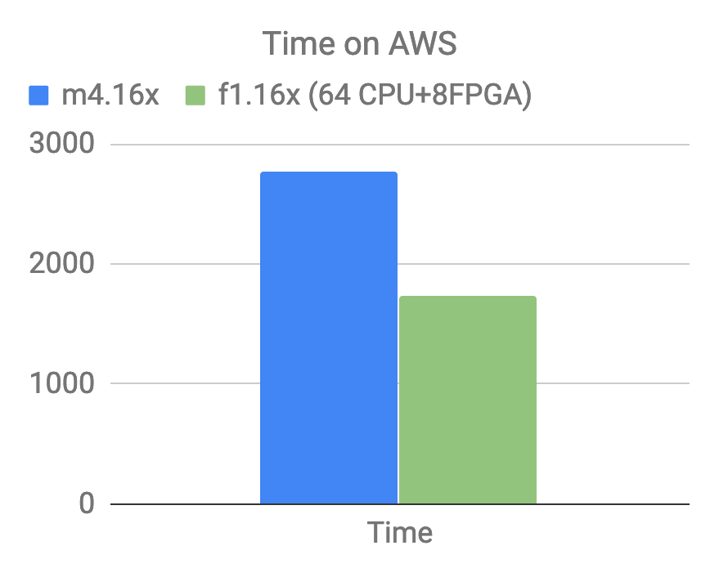
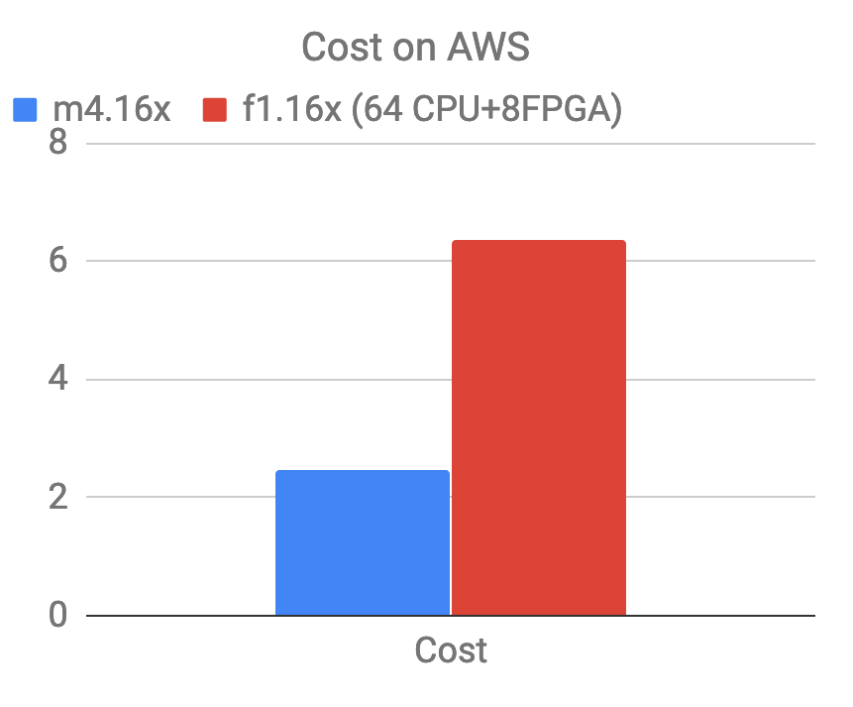
Motivation: How Does Using FPGA Accelerators Impact an Application’s Out-of-Pocket Cost in Public Cloud Services?
From CPU solution -> CPU + FPGA for HTC on AWS Cloud
Latency improves 1.60x
Cost 2.58x
Notes:
When we deploy the accelerator in public cloud, one of the key questions arise is that: how does using FPGA accelerators impact an application’s out-of-pocket cost in public cloud services, such as Amazon web service, google cloud or Huawei cloud. It turns out using FPGA usually brings in benefit in getting a smaller runtime, however, it does not guarantee cost savings. For example, when we deploy HTC, one key application in GATK, in AWS cloud by using FPGA accelerator, the latency improves by 1,6x, however, as shown in the right chart, the cost improves by 2.6x.

Slide 4
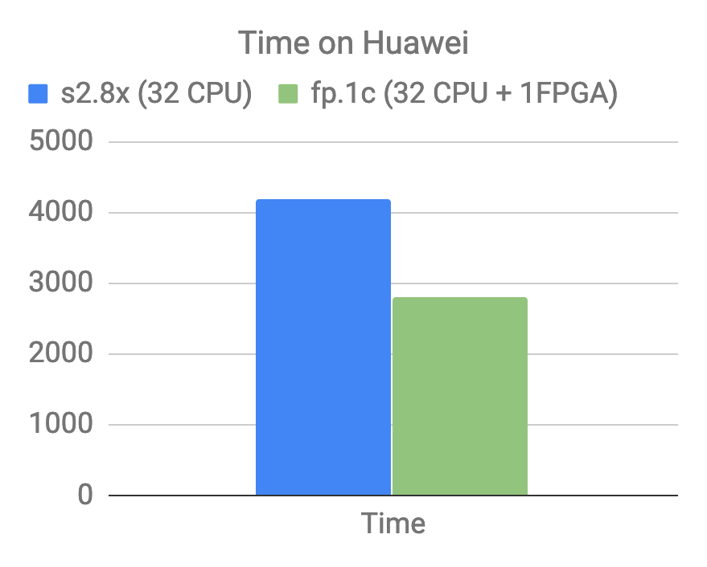
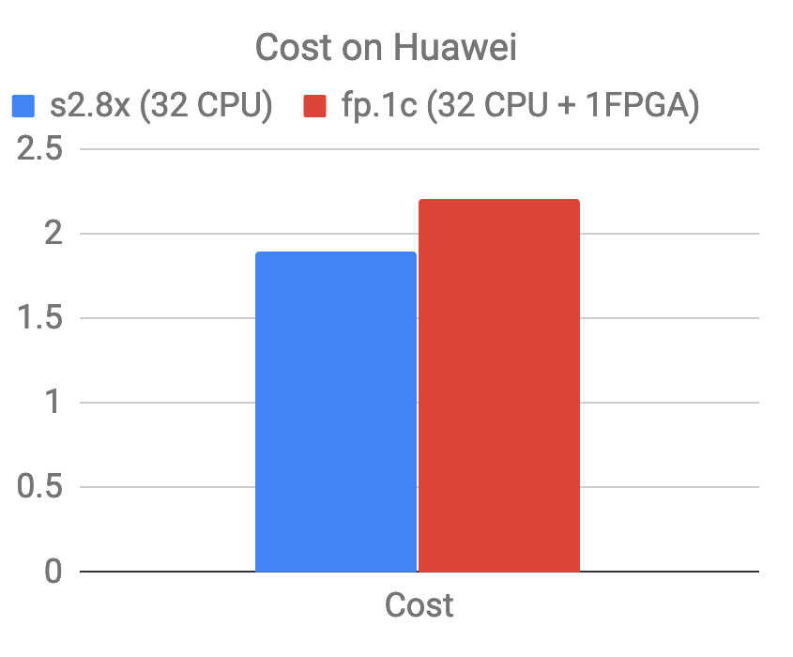
Motivation: How Does Using FPGA Accelerators Impact an Application’s Out-of-Pocket Cost in Public Cloud Services?
From CPU solution -> CPU + FPGA for Mutect2 on Huawei
Latency improves 1.49x
Cost 1.16x
Notes:
Similarly, when we deploy Mutect2, another key application in GATK in Huawei cloud with FPGA accelerator, the latency improves by 1.5x, however, the cost increased by 1.16x.

Slide 5
Why?
FPGA is not cheap in public cloud
AWS, 1 FPGA = 25 vCPU in price
Huawei, 1 FPGA = 23 vCPU in price
Amdahl’s law
the theoretical speedup is always limited by the part of the task that cannot benefit from the improvement.
For HTC, PairHMM kernel takes 39%
Application speedup is bounded by 1/(1-0.39) = 1.63
Notes:
Why is that? Firstly, FPGA is not cheap in public cloud. In AWS, 1 FPGA is priced at around 25 CPU cores. In Huawei cloud, 1 FPGA is priced at 23 CPU. However, due to the Amdahl’s law, theoretical speedup is always limited by the part of the task that cannot benefit from the improvement. For example, in HTC, pairHMM kernel that can be accelerated takes only 39% of the whole application. The application speedup is thus bounded by 1.6x.
In this case, The CPU-FPGA instance is priced at 4x more than pure CPU instances, and what users pay for FPGA dose not brings throughput improvement in return.

Slide 6
Challenges
Applications are different
 | r (kernel ratio) | S (speedup)
BWA (SmithWaterman) | 0.4 | ~16
Samtools (deflate) | 0.2 | ~12x
GATK3.6 (pairHMM) | 0.4 | ~40x
BWA, Samtools, GATK3.6 are all single node, multi-thread program
BWA, Samtools in C, GATK3.6 in Java
Notes:
And this applies to different application where the accelerated portion ratios are different, and accelerator speedup are different.

Slide 7
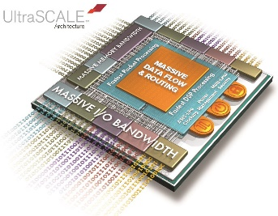
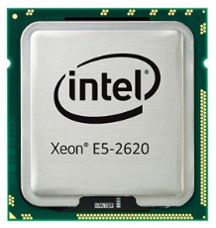
Performance Model on CPU-FPGA Platform
“Well Matched” FPGA vs CPUs
e.g. r = 0.5, S = 8, P = 8
Notes:
In order to model and optimize the cost when deploying FPGA accelerators. We summarize three cases in CPU-FPGA platform. The first one is well match FPGA and CPU where the throughput of CPU cores and FPGA accelerators match each other.

Slide 8
Performance Model on CPU-FPGA Platform
Fast FPGA
e.g. r = 0.39, 1-r/r = 1.56, S = 40, P’ = 64 P = 8,
Leave 1-8/64 = 87% FPGA resource idling, Waste!
Notes:
The second case is fast FPGA. Where the FPGA resource is not fully utilized and wait for CPU to either produce the data or consume the data.

Slide 9
Performance Model on CPU-FPGA Platform
Slow FPGA
e.g. r = 0.83, 1-r/r = 0.2, S = 40, P’ = 8 P = 32,
Leave 32-8 = 24 CPU cores idling, Waste!
Notes:
The third case is slow FPGA. Where the CPU resource is not fully utilized and wait for FPGA to either produce the data or consume the data. For the 2nd and 3rd cases, either FPGA or CPU is not fully utilized and the allocated resource is wasted.

Slide 10
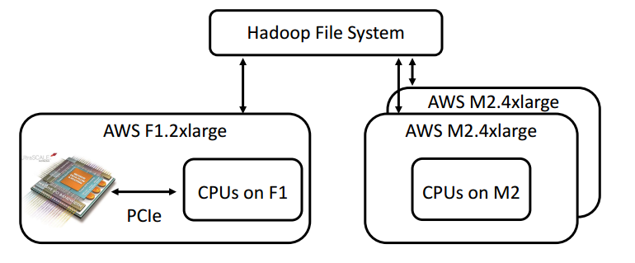
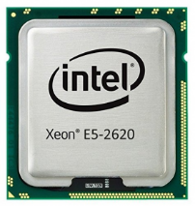
Proposed Optimization for Fast FPGA: Sharing FPGA among Instances
Matching throughput of CPUs and FPGAs
Network
network
network
Notes:
To optimize the second case, we propose to launch more CPU nodes to fully utilize the FPGA nodes to match the throughput of CPUs and accelerators.

Slide 11
Proposed Optimization for Slow FPGA: Co-execution of FPGA+CPU
Partial Offload: Co-execution of FPGA + CPU
M1 tasks: Offload acceleratable kernels to FPGAs
M2 tasks: Instead of offload, schedule to CPUs
Notes:
To optimize the third case, we propose to offload accleratable kernels back to CPUs to keep CPU resources fully utilized instead of waiting for the offloaded tasks to be finished on FPGA.

Slide 12
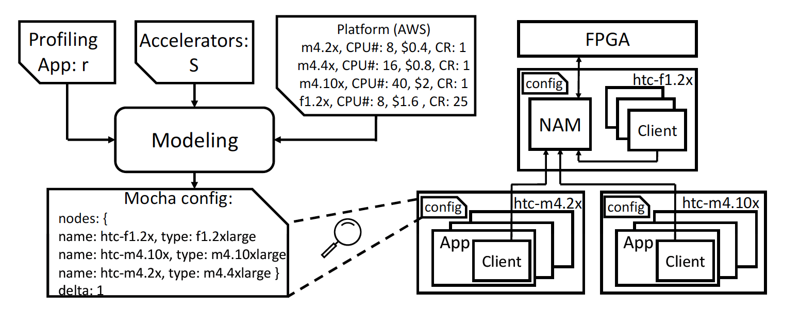
Mocha: Multinode Optimization of Cost in Heterogeneous Cloud with Accelerators
1: Profiling r + Speedup S -> Matching Core Number, P’
2. Setting up cluster
HTC on AWS, P’ = 64
Instances: f1.2x: 8, m4.10x: 40, m4.4x: 16
3. Mocha Runtime CPU clients <-> NAM <-> Accelerator
Notes:
We integrate these optimization techniques and propose Mocha as shown here. Mocha first use app profiling and accelerator speedup to calculate the optimal CPU/FPGA resource allocation schemes, then setup the cluster and request the resources on public cloud. Mocha runtime launches node accelerator manager to communicate with CPU clients and FPGA accelerators to fully balance the workload.

Slide 13
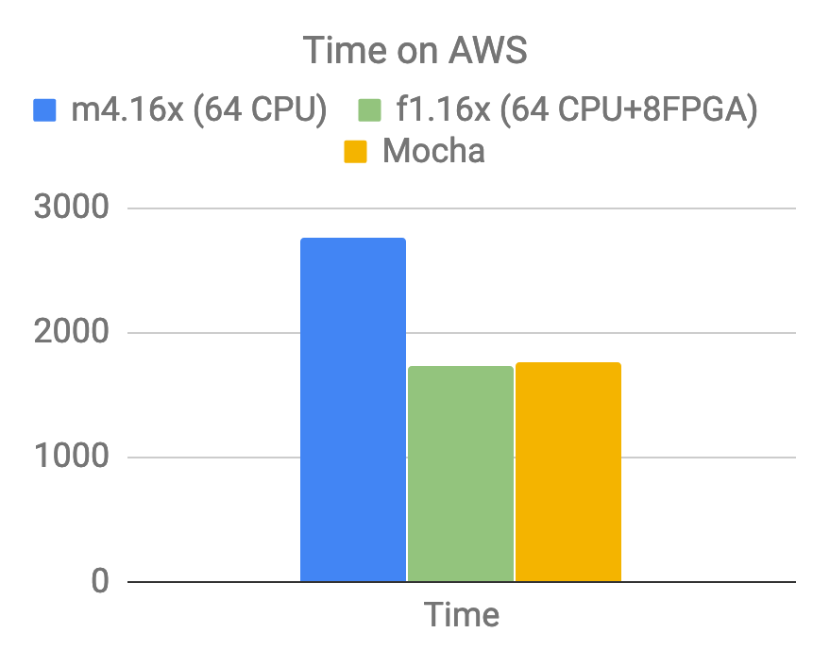
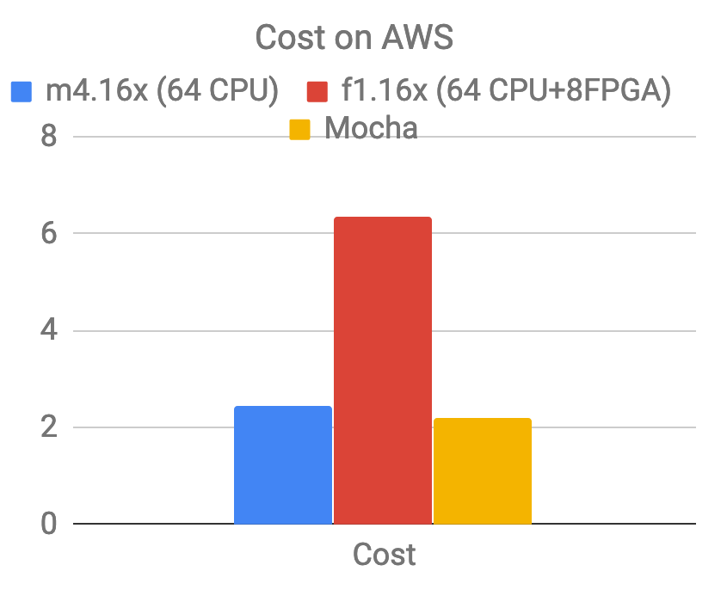
Optimization Results
HTC on AWS EC2
Latency improves 1.60x -> 1.58x, almost same performance
Cost 2.58x -> 0.93x, cost efficiency improvement: 2.77x
f1.16x (64 CPU+8FPGA) ->f1.2x + m4.16x (64 CPU +1 FPGA)
Make more use of 1 FPGAs
Notes:
By using Mocha, we bring down the cost by deploying FPGA in AWS by 2.77x with less than 5% performance degradation for HTC applications

Slide 14
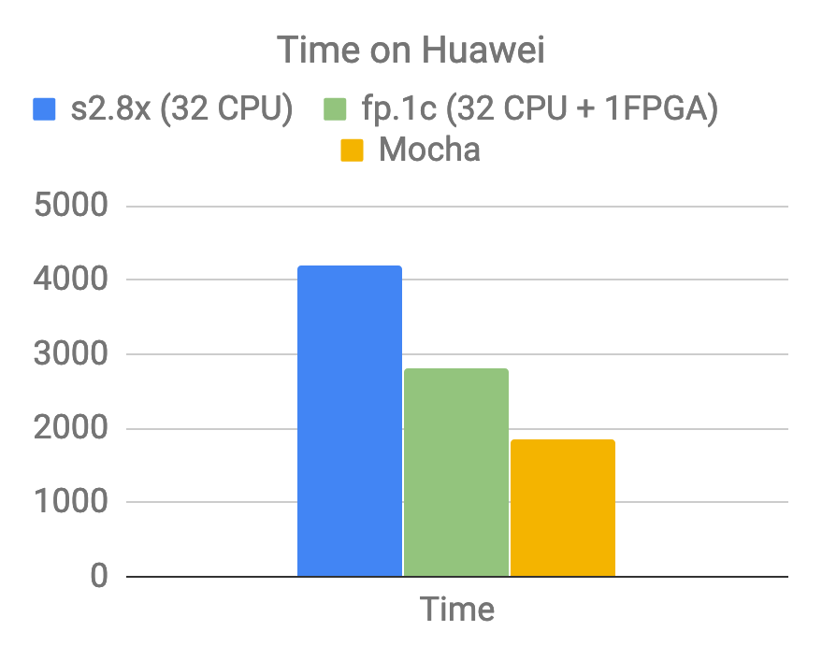
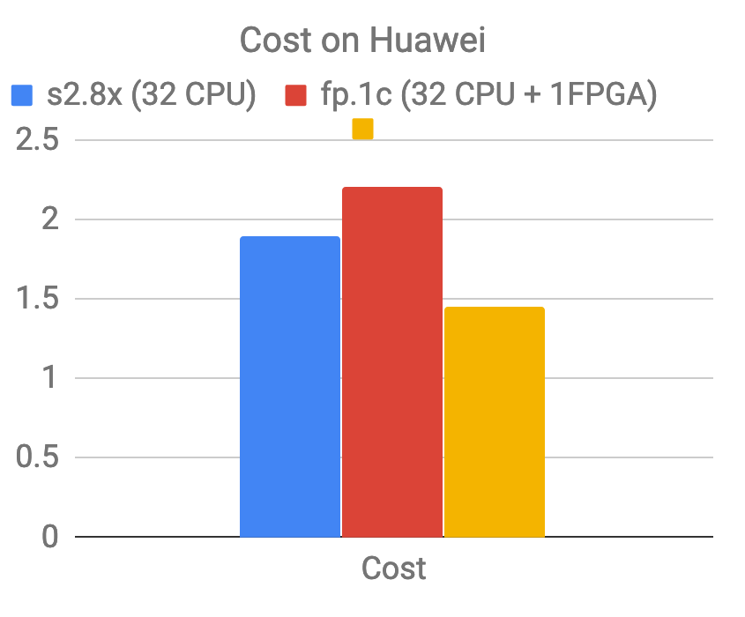
Optimization Results
Mutect2 on Huawei Cloud
Latency improves 1.49x -> 2.27x, performance improvement: 1.5x
Cost 1.16x -> 0.76x, cost efficiency improvement: 1.5x
Effective CPUs: 8 -> 32, Make more use of CPUs
Notes:
In Huawei Cloud, we bring down the cost by deploying FPGA by 1.5x with 1.5x speedup in the application runtime. In conclusion, Mocha provides an optimal CPU/FPGA resource allocation in terms of cost in public cloud.
If you are interested in knowing more about Mocha, please don’t hesitate to email me and I am more than happy to answer. Thank you for your time!

